Slide 1

Data Analytics on Conference Session Catalog using Jupyter Notebooks handson workshop
Lucas Jellema
Conclusion Machine Learning Gilde
21 februari 2019

Slide 2

Hands On met Jupyter Notebooks in vier stappen
Een werkende Jupyte Notebook Server omgeving
Lokaal – op basis van Docker container
Cloud – in een KataCoda omgeving
Hello World Notebook
Eerste stappen met Notebook, Markdown, Python & Pandas
Casus Oracle OpenWorld 2018 Session Catalog
Gather
Wrangle
Analyze
Visualize
Doe Het Zelf Notebook met Titanic Data Set
Resources: bit.ly/conclusion-notebook

Slide 3
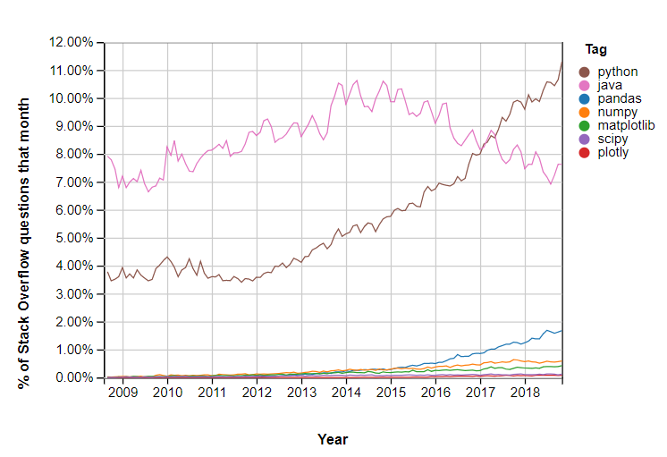
Groeiende belangstelling in Python…
Resources: bit.ly/conclusion-notebook
Notes:
https://insights.stackoverflow.com/trends?tags=pandas%2Cnumpy%2Cmatplotlib%2Cplotly%2Cscipy

Slide 4
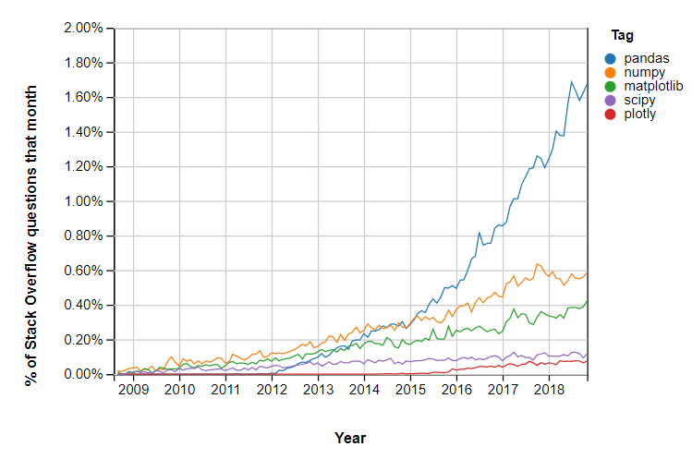
.. en in een specifieke Python Library in het bijzonder
Resources: bit.ly/conclusion-notebook
Notes:
https://insights.stackoverflow.com/trends?tags=pandas%2Cnumpy%2Cmatplotlib%2Cplotly%2Cscipy

Slide 5

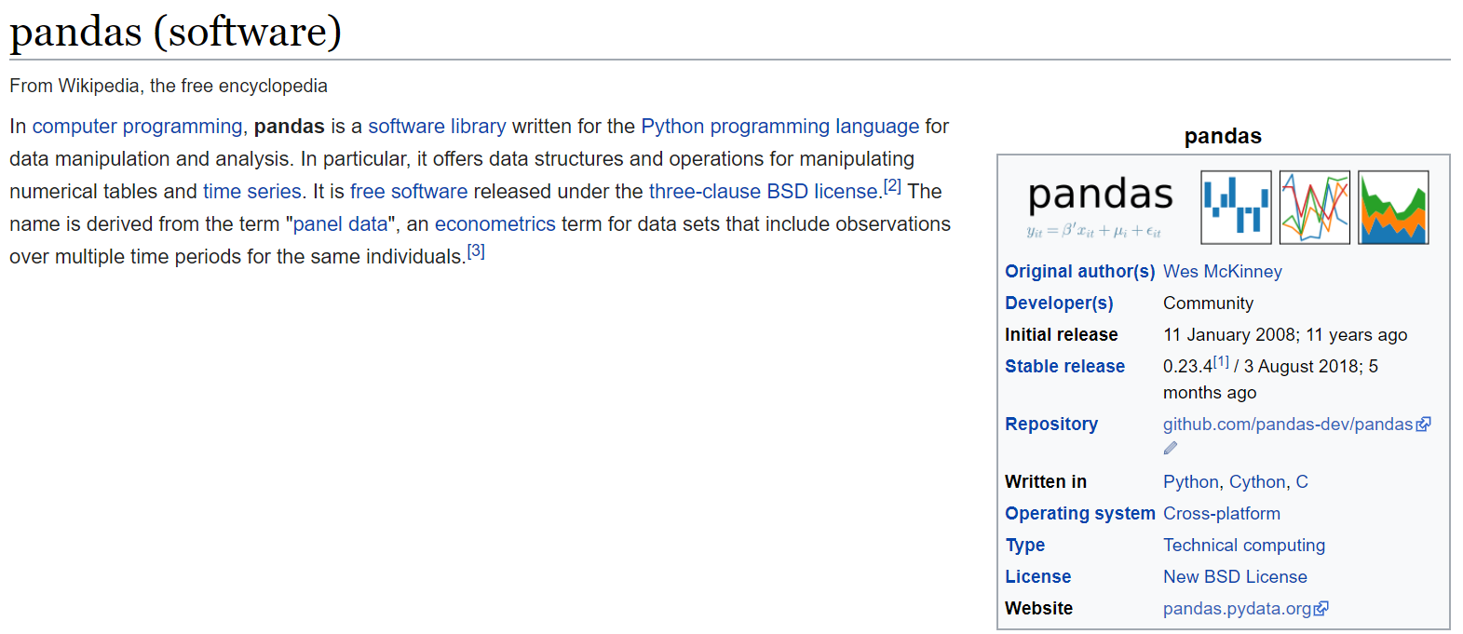
Notes:
Shift + tab (+ tab ) == help!!
Tab = autocomplete
Use ? To get docs on module (venn2? And ctrl+enter)

Slide 6
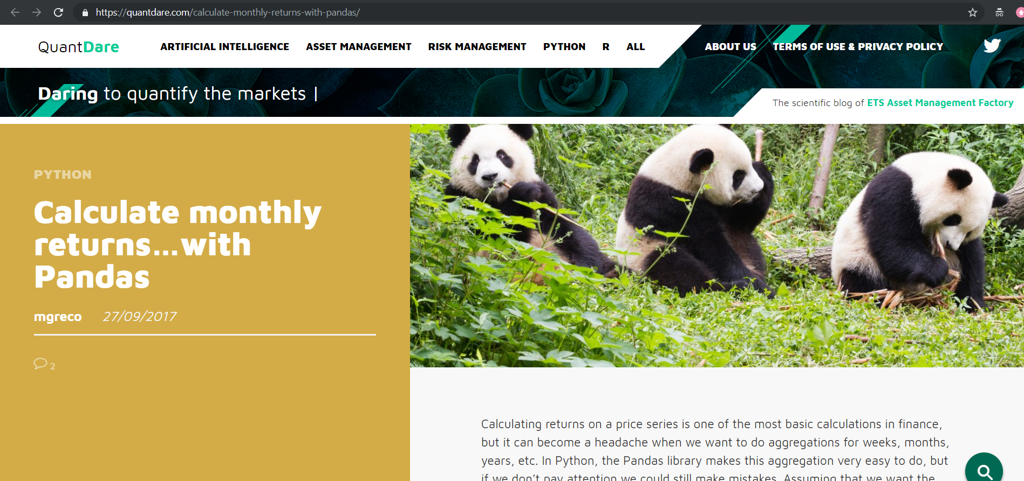

Slide 7

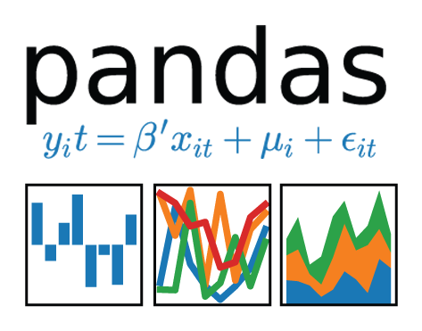

Slide 8
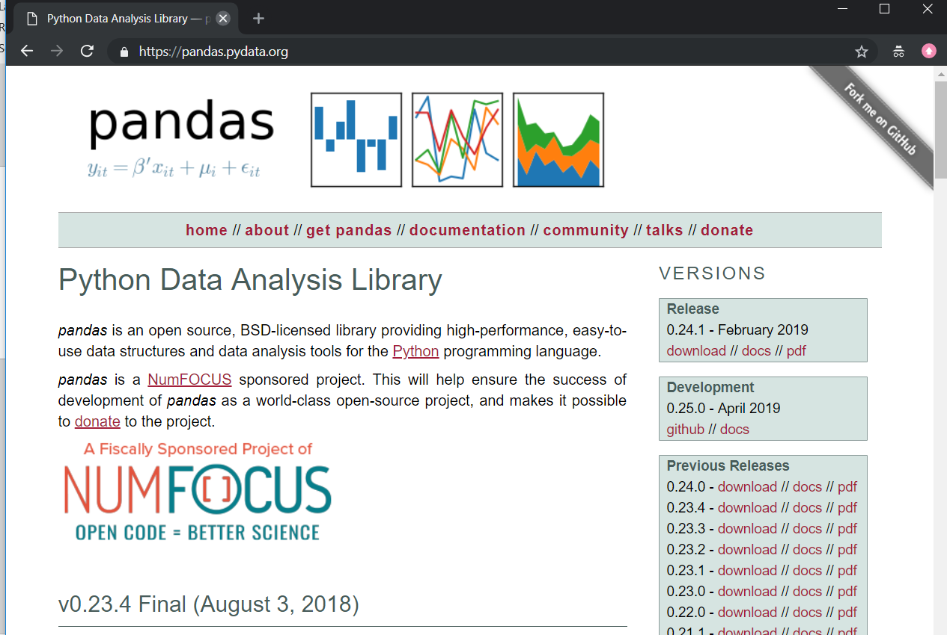

Slide 9
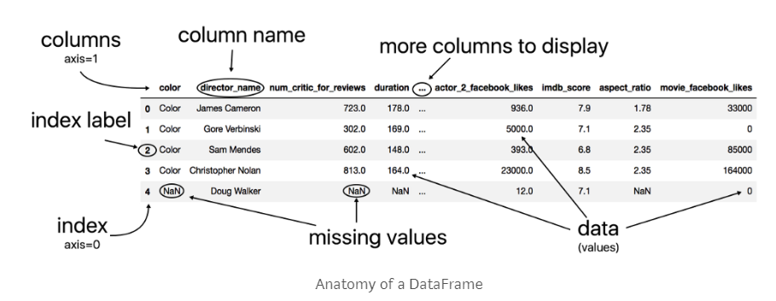
Pandas = Panel Data
Notes:
Learn pandas: https://medium.com/dunder-data/how-to-learn-pandas-108905ab4955
10 minutes to pandas: http://pandas.pydata.org/pandas-docs/stable/10min.html
https://towardsdatascience.com/pandas-dataframe-a-lightweight-intro-680e3a212b96

Slide 10
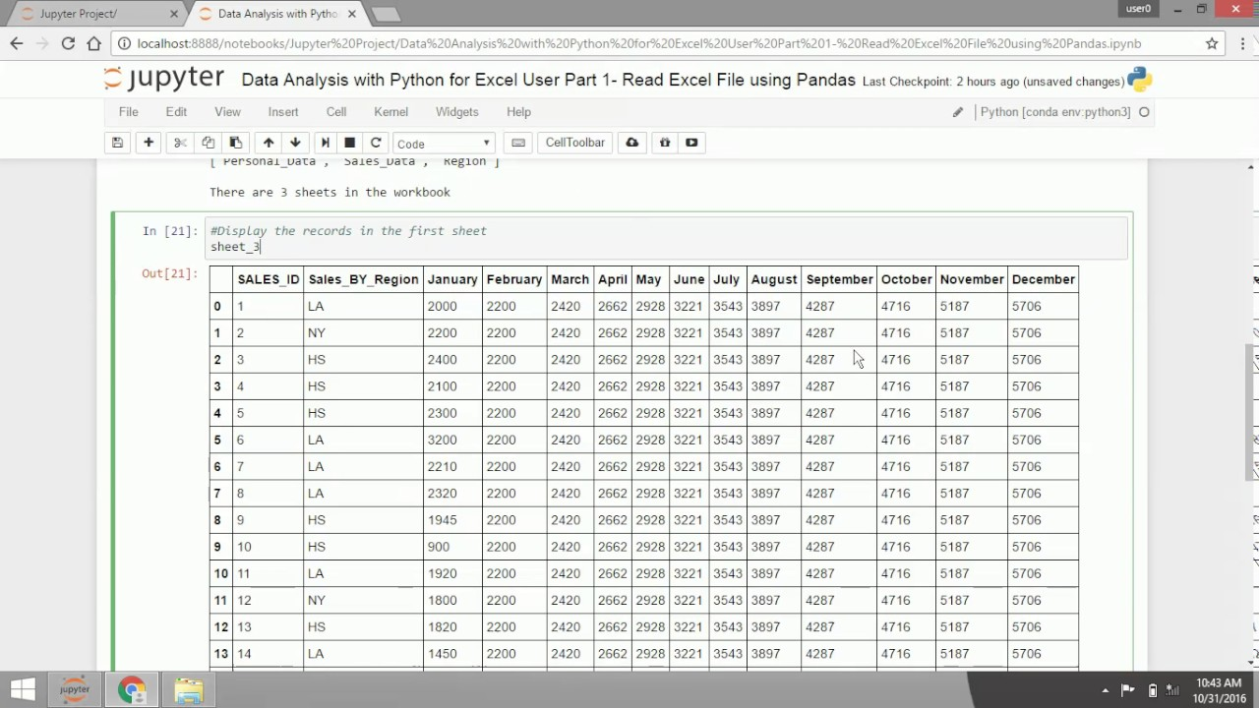

Slide 11
Een paar operaties op een Pandas Data Frame
df.dtypes – alle data types van alle kolommen
df['column_name'].value_counts – telling van aantal verschillende waarden
df.head(5) – toon de eerste vijf rijen van het data frame
df['column_name'].head(5) (of .tail(10))
df[['column_name', 'column_name_2']].head(5)
pd.crosstab(df['column_name'], df['column_name_2']) – kruistabel
df['column_name3'] = 2 * df['column_name'] – voeg een kolom toe
df['column_name3'] = df['column_name'].apply(len) – bepaal waarde van nieuwe kolom door toepassen van een functie op een bestaande kolom
df['column_name3'] = df.apply(lambda row: 'Y' if row['column_name'] == 'HOT' else 'N') – bepaal waarde van nieuwe kolom op basis van conditie
df.drop('column_name3') – verwijder kolom

Slide 12
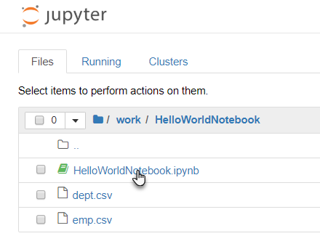
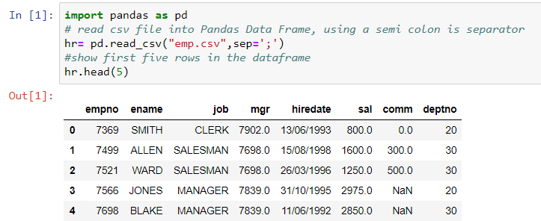
Hello World Notebook
Als je omgeving draait
Lokaal of Katacoda
Open dan het Notebook HelloWorldNotebook.ipynb in folder /work/HelloWorldNotebook
Stap door de cellen lees de instructie voer de opdrachten uit

Slide 13
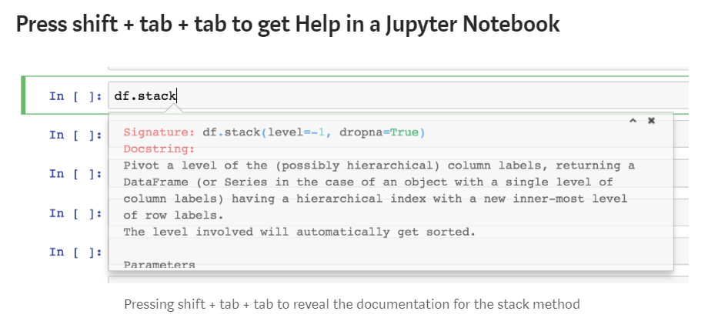
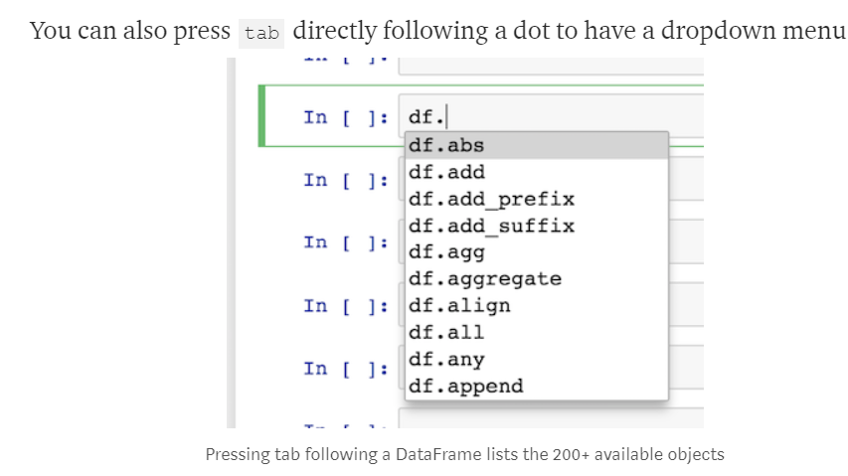

Slide 14
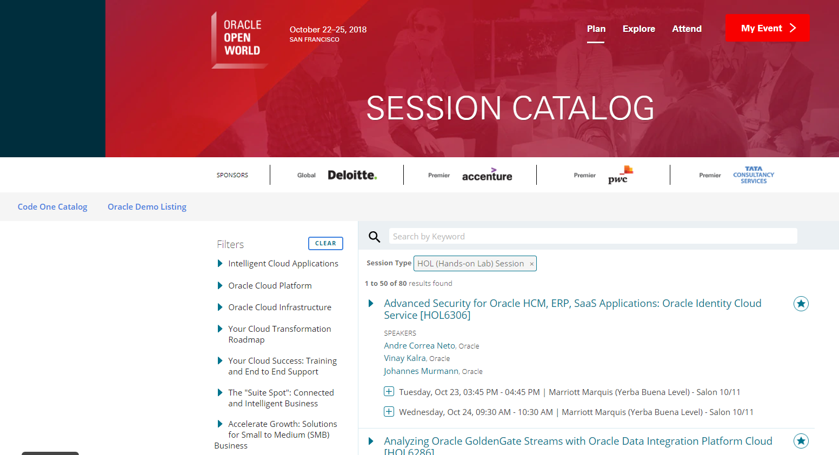
Data Analytics on Oracle OpenWorld 2018 Session Details

Slide 15

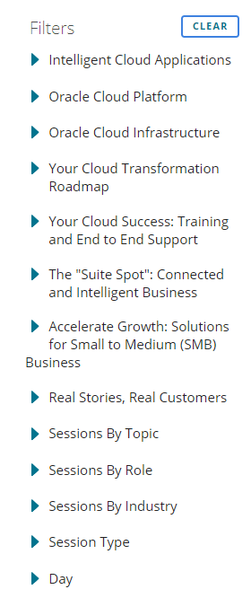

High level overview
Two events: Oracle OpenWorld 2018 and Oracle CodeOne 2018
Over 2000 sessions
Over 2500 speakers
Various dimensions:

Slide 16
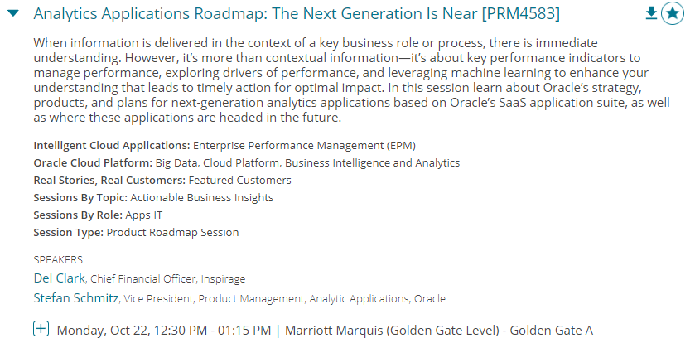
High level overview
Details per session:

Slide 17

High level overview
Details per speaker:

Slide 18

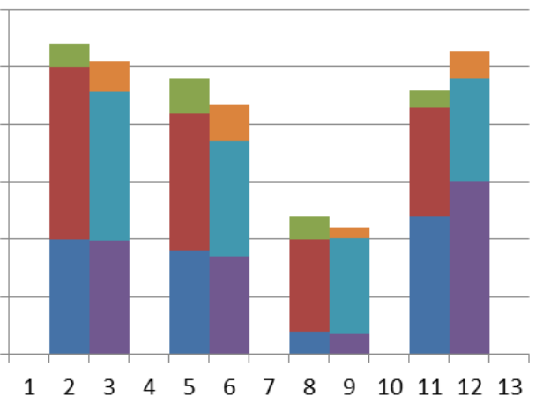

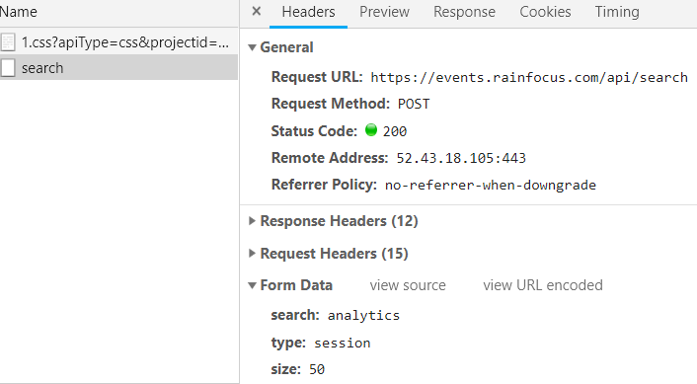
Flow for Oracle OpenWorld 2018 Session Data Analytics
Data Gathering
Data Wrangling
Business Intelligence
Report & Visualization on Speakers
API for session details in JSON
Report & Visualization on Sessions
Machine Learning
AMIS Kick Off 2019 - Proposities & Data Analytics

Slide 19

Flow for Oracle OpenWorld 2018 Session Data Analytics
3
Exploration of Conference Speakers , visualizations, business insights and answers.
1
2
From Raw, External, Slow/Unavailable Data
to local, accessible, still fairly raw Data Lake
To a consolidated, cleansed, formatted, unified Data Set with derived and enriched values
Gender guesser
Jupyter Notebook & Python
Report & Visualization on Speakers
API for session details in JSON
Jupyter Notebook & Python
Jupyter Notebook & Python
JSON file
JSON files
Jupyter Notebook & Python
Report & Visualization on Sessions
AMIS Kick Off 2019 - Proposities & Data Analytics
4
Exploration of Session Details, visualizations, business insights and answers.

Slide 20
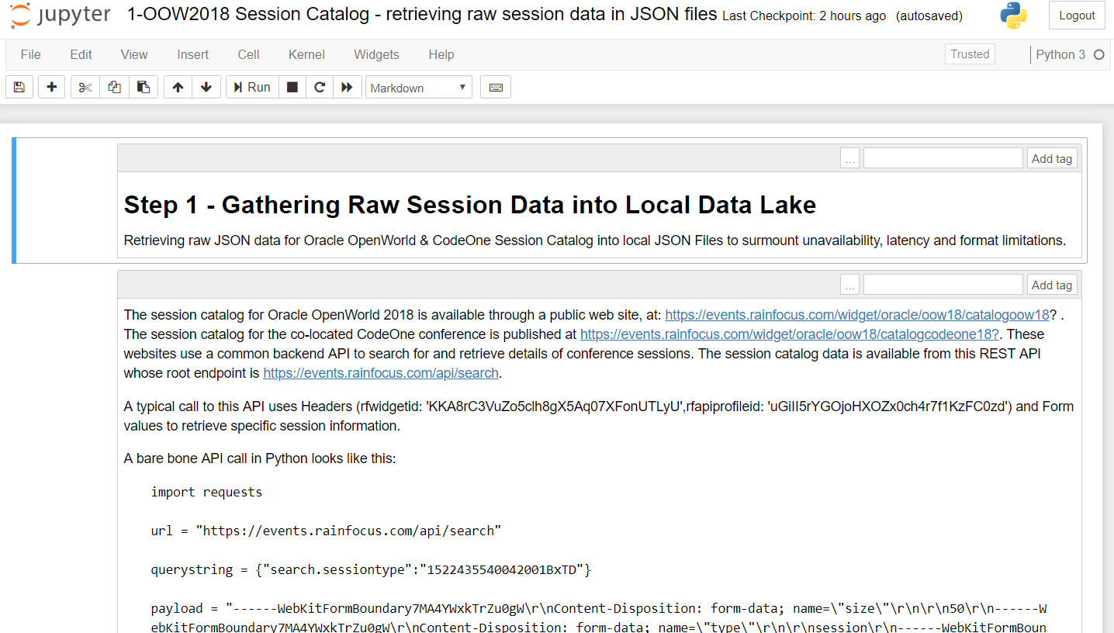
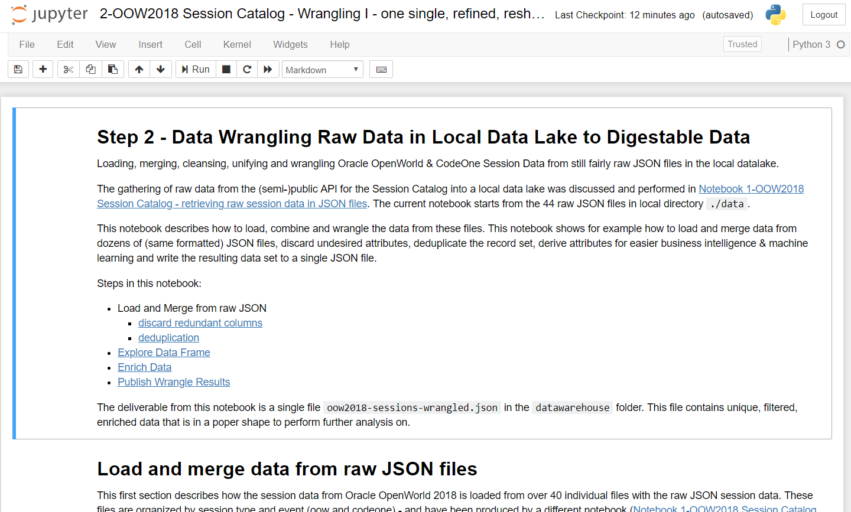
Data flow for Oracle OpenWorld 2018 Session Data
Speakers:
Read JSON file, extract speaker details, visualize and analyze speaker data
Fetch all raw session data per Event and per Session Type from API and write to 44 local JSON files
Read all JSON files, discard unneeded attributes, derive new attributes, deduplicate records and write to a single local JSON file
Gender guesser
Jupyter Notebook & Python
Report & Visualization on Speakers
API for session details in JSON
Jupyter Notebook & Python
Jupyter Notebook & Python
JSON file
JSON files
Jupyter Notebook & Python
Report & Visualization on Sessions
oow2018-sessions-wrangled.json
AMIS Kick Off 2019 - Proposities & Data Analytics
Sessions:
Read JSON file, visualize and analuyze session data
/datalake
/datawarehouse

